Slide 1
MANAGE SUCCESSFUL FIELD RESEARCH 2024

Slide 2
Stata: Data Visualizations
Ankriti Singh
Research Consultant

Slide 3
Outline
Descriptive Statistics
Summary tables
Balance tables
Regression tables

Slide 4
Overview: Stata Labs
Introduction to Stata
Data Cleaning & Tidying
Descriptive Analysis with tables
Descriptive Analysis with graphs

Slide 5
Today’s lab
Introduction to Stata
Data Cleaning & Tidying
Descriptive Analysis with tables
Descriptive Analysis with graphs

Slide 6
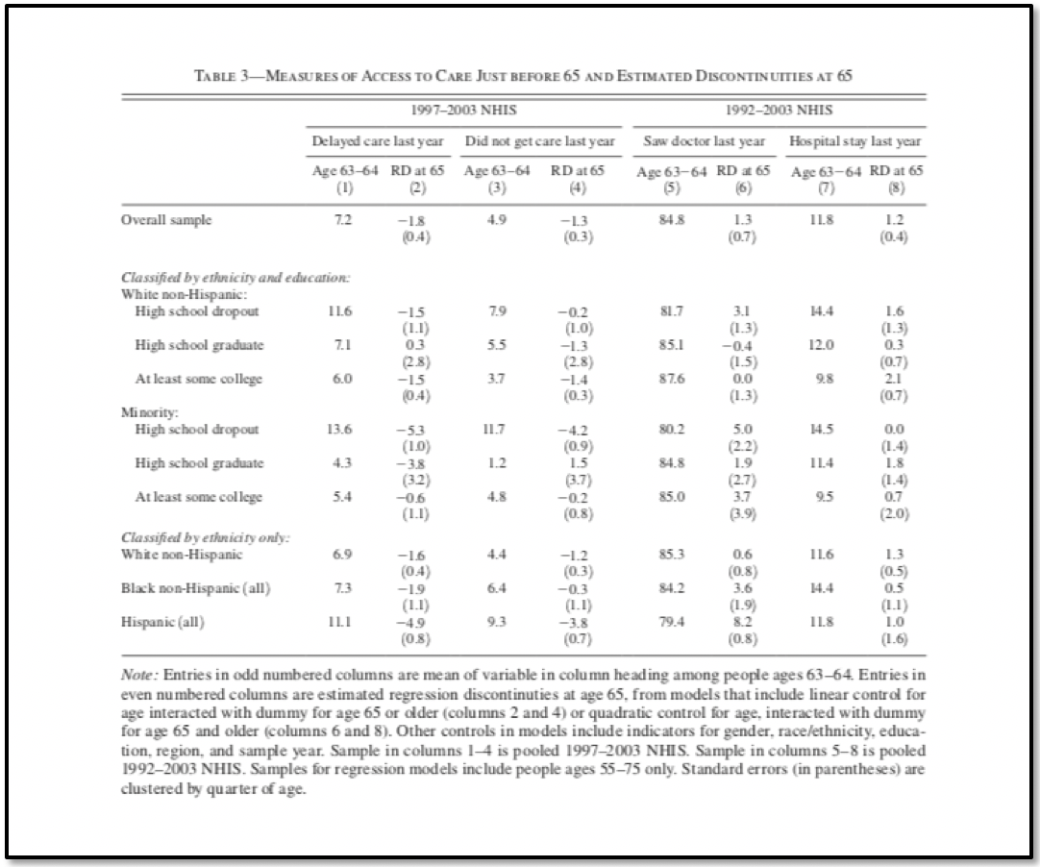
How to present your results?
What is happening in this regression table?
What is important?
What are the main take-aways?

Slide 7
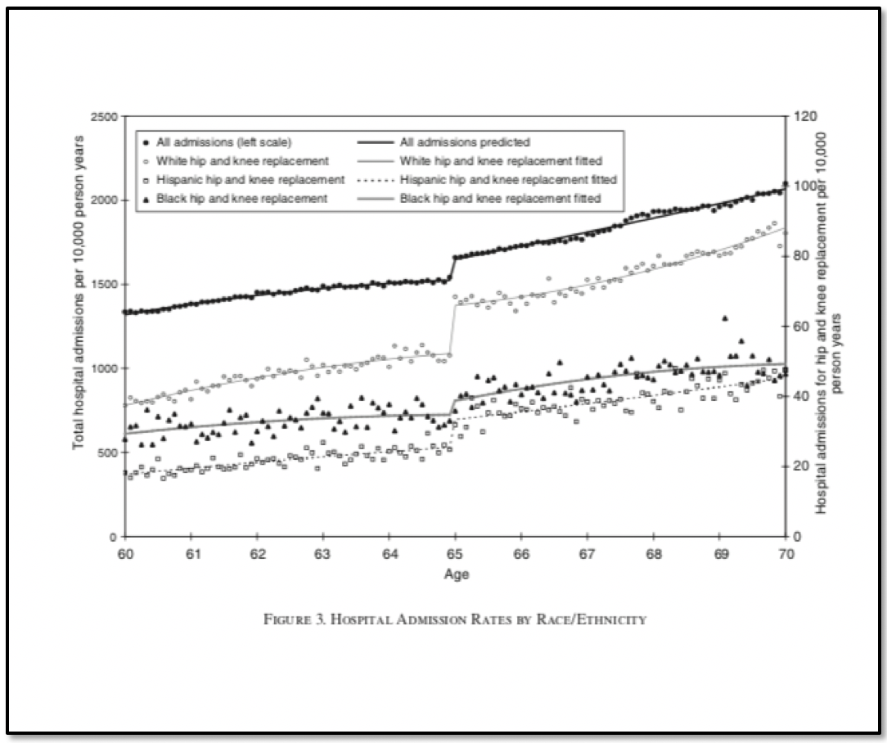
How to present your results?
This graph is based on the same data as the table on the previous slide
In the graph, you can easily see what is happening very quickly

Slide 8
Choose the best visual aid for your data
When to use tables?
When to use figures?
To present information-dense data in an organized and easy-to-read format
To compare data with different units of measurements across multiple categories
To analyze data to understand causes, outcomes, and specifics.
Examples: Summary tables, balance tables, Regression tables
To simplify complex data to highlight important results in a visual and easy-to-digest format
To visualize patterns and trends in data, or to find relationships between key variables
Examples: Distribution curves, bar graphs, scatter plots, line graphs

Slide 9
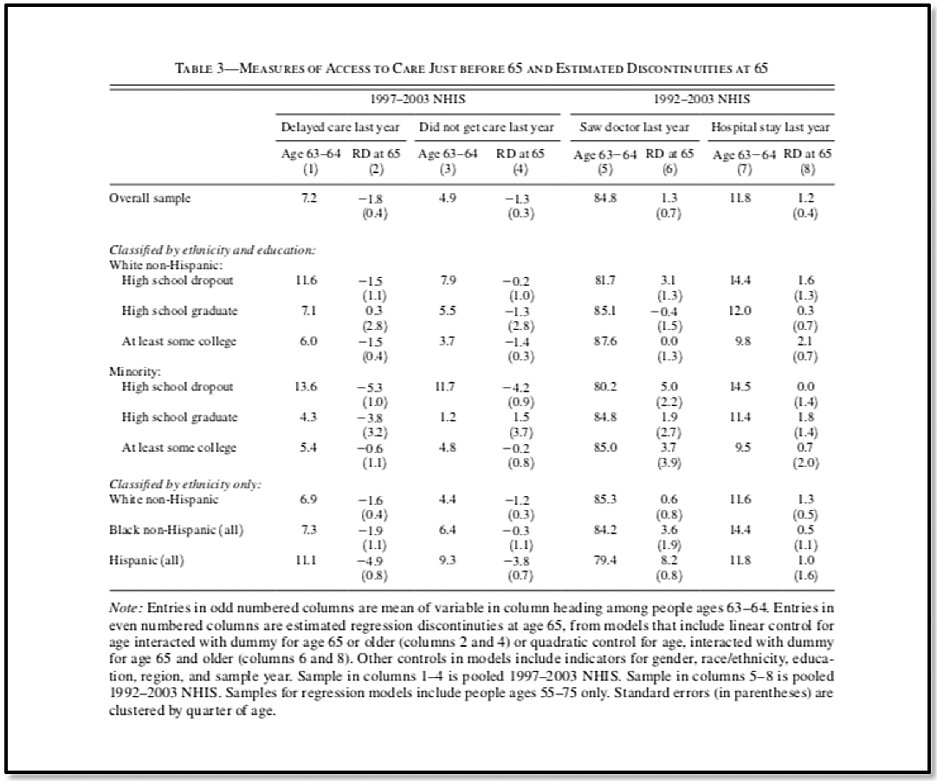

Choose the best visual aid for your data
Gives all the details!
Highlights the story!

Slide 10
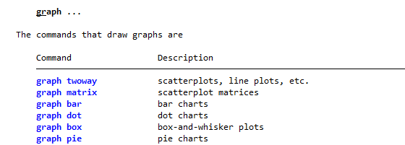
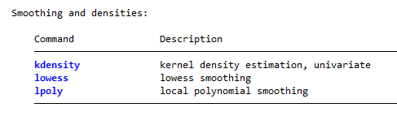
Graphs in Stata
graph graphtype plots one or more variables on one axis
graph twoway plots 2 or more variables on x and y axis
histogram, kdensity: essential distribution commands

Slide 11
Oneway graph plots

Slide 12
Setting the stage
Launch Stata
Open lab4.do in
Load the clean dataset

Slide 13
Task 1: Visualize Distributions
Use histogram to explore distribution of number of adults and non-food consumption value
How do the distributions differ for these two variables?
What option will you add to make the distribution of number of adults to look better?
Create the distributions again but instead of showing density, show the frequency
Use kdensity to explore the distribution of non-food consumption value
Restrict the values to less than 1000000

Slide 14
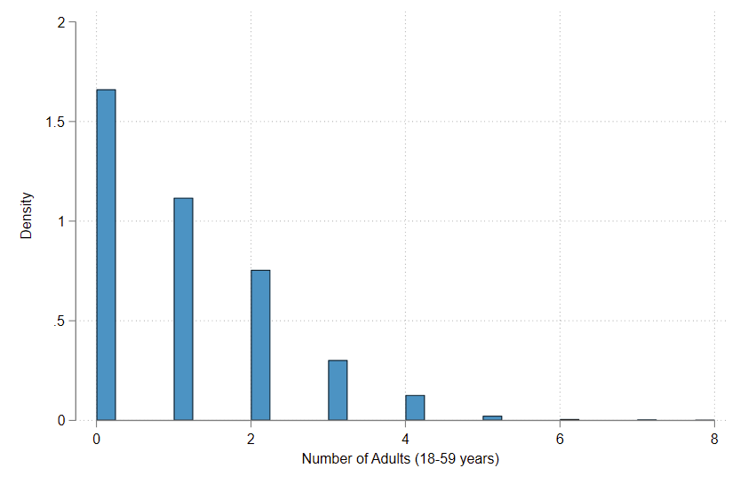
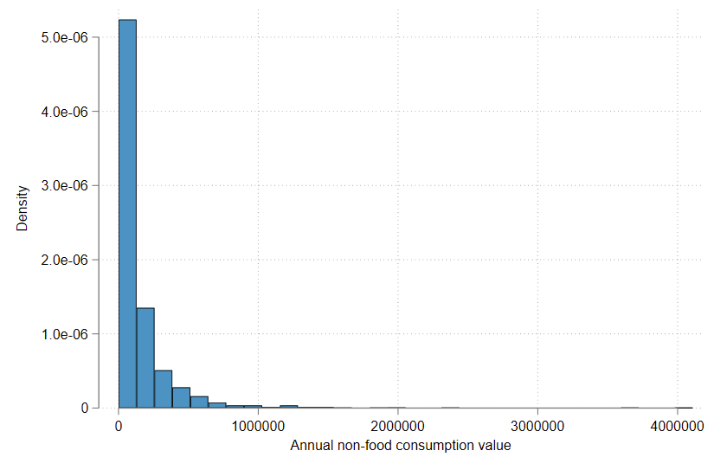
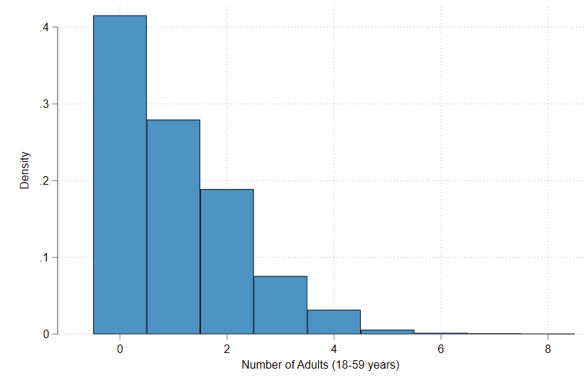
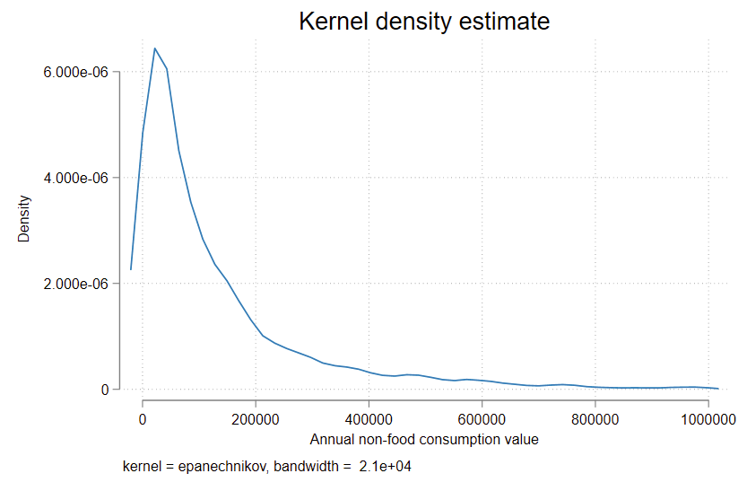
Visualize distributions

Slide 15
Task 2: Explore categorical variables
Use gr bar to explore the variable crop_damage
What does the graph show?
Use the option over() to breakdown the bar graph into categories of Treatment and Control
Use (stat), where stat represents the statistic to be calculated, to show the median instead of mean of the production value

Slide 16
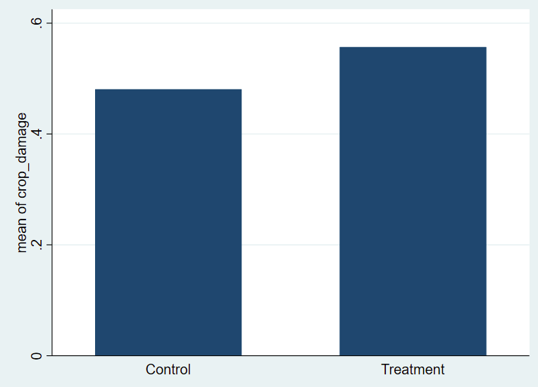
Exploring categorical variables

Slide 17
How to make a figure look better?
Figures should be self-contained:
Title should be descriptive
Axis titles should be informative (should include unit of measure of data)
Legend and data labels should identify the symbols or colors used to represent the data in the chart
Notes should include all the additional info needed to understand the figure e.g., definition

Slide 18
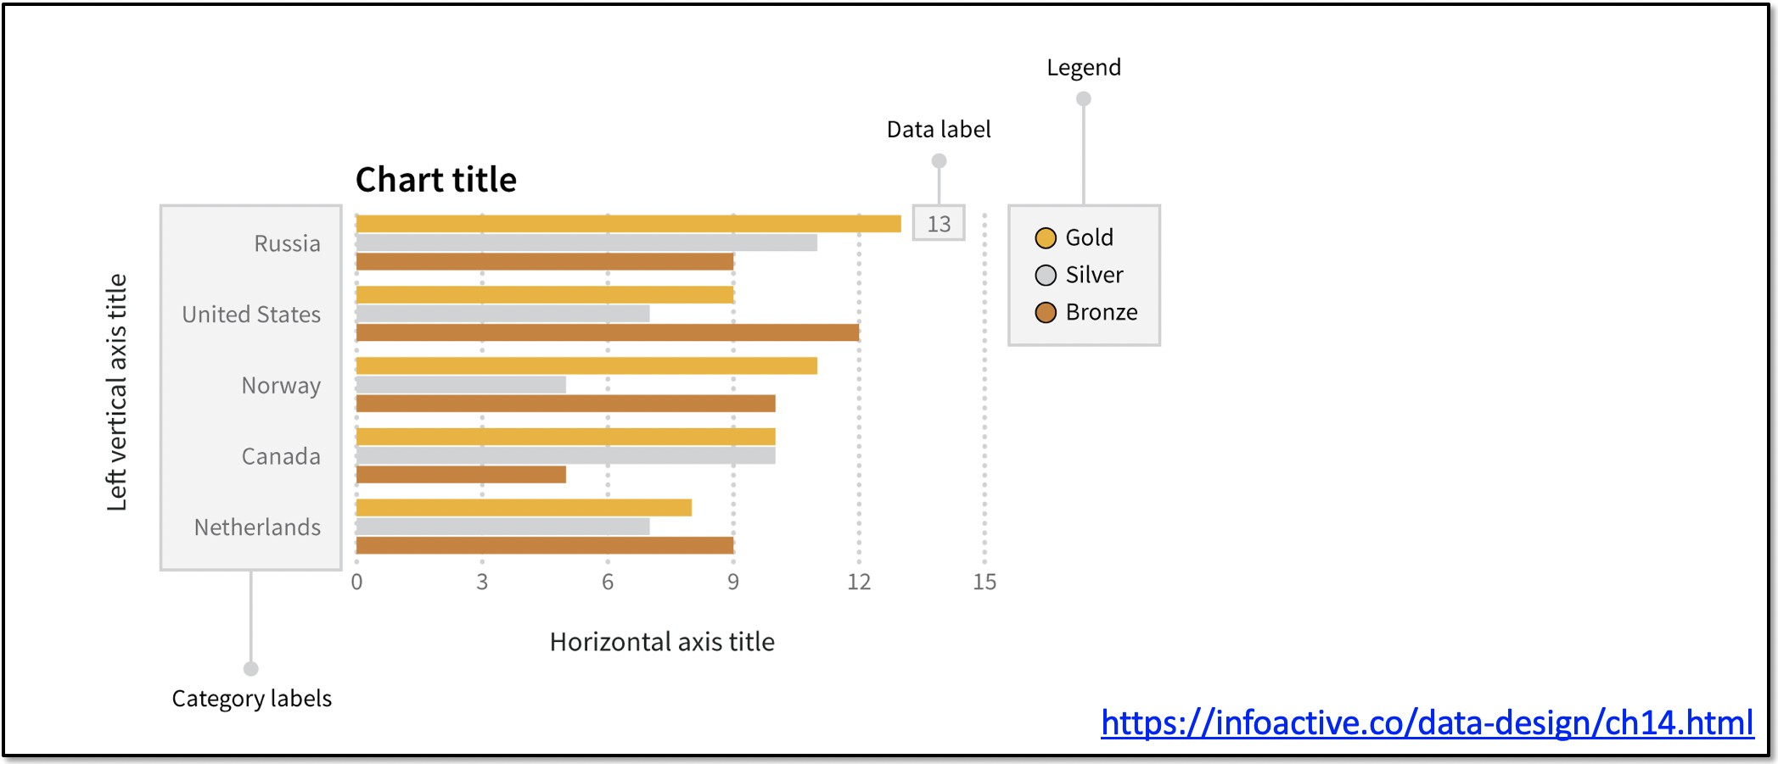
Anatomy of a figure

Slide 19
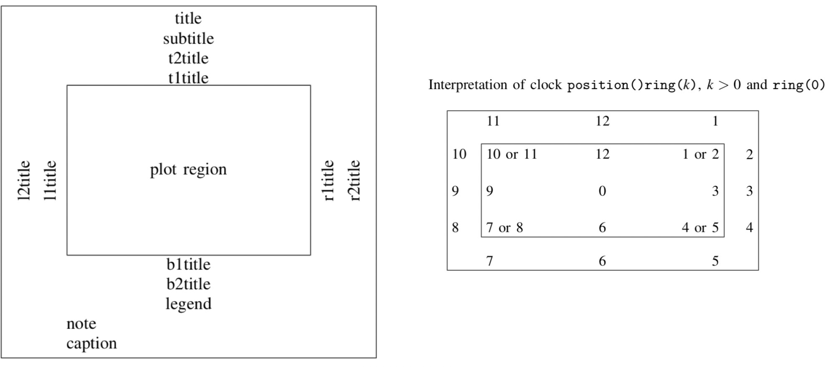
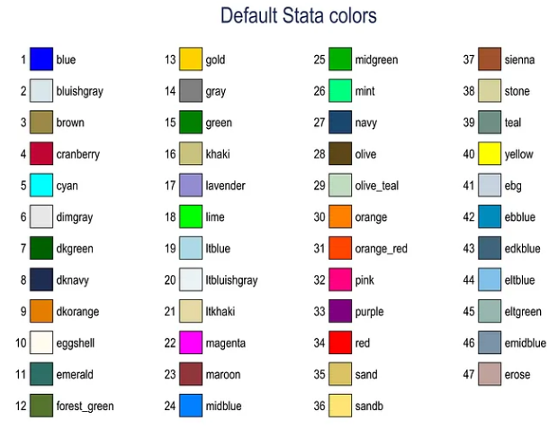
Components of Stata graphs

Slide 20
Task 3A: Use the right
Use gr bar to show the distribution of households by various sources of drinking water (display the percentage breakdown)
gr bar, over(water)
Is it easy to read all the labels?

Slide 21
Task 3B: Formatting graphs
Use gr hbar instead
Add the title to the graph
title()
Add the title to the y-axis
ytitle()
Add labels to the bars
blabel(bar, format(%9.1f))
Change the color of bars
bar(#, color(colorname))
Change the background color to white
graphregion(color(colorname))

Slide 22
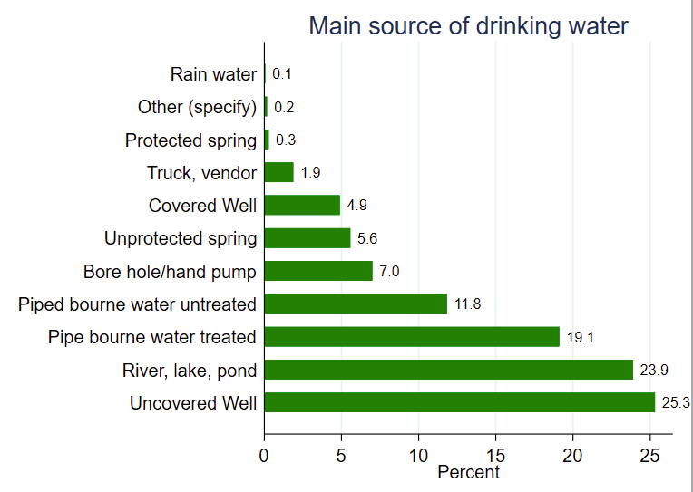
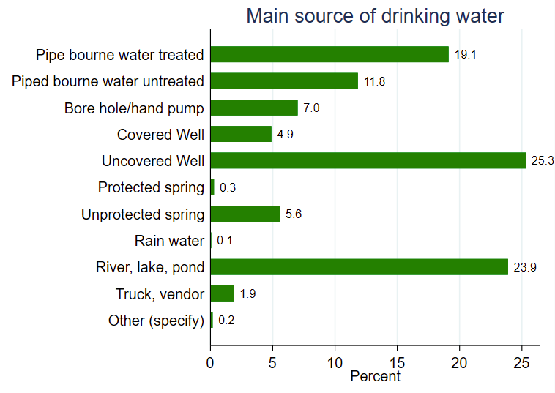
Formatting graphs
After sorting by bar height:
gr bar, over(water, sort(1))
....

Slide 23
Task 4: Box plots
Use gr box to show the distribution of duration over enumerators
gr box, over()
Use sort(1) with over to sort from lowest to highest
Add title and change the background color to white
Which enumerator has the shortest average duration?
Are there any outliers among enumerators with instances of longer duration?

Slide 24
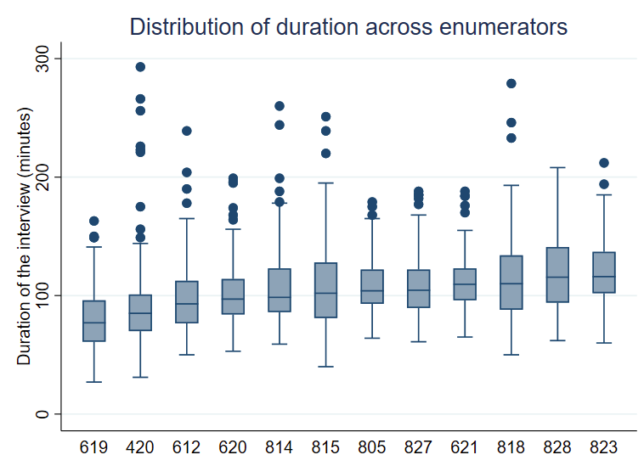
Box plots

Slide 25
Task 5: Pie charts
Use gr pie to show the distribution of religion of the household head
gr pie, over()
Put the slices in the order of the size of the slice using sort
Add title and change the background color to white
What is the most and the least common religion?

Slide 26
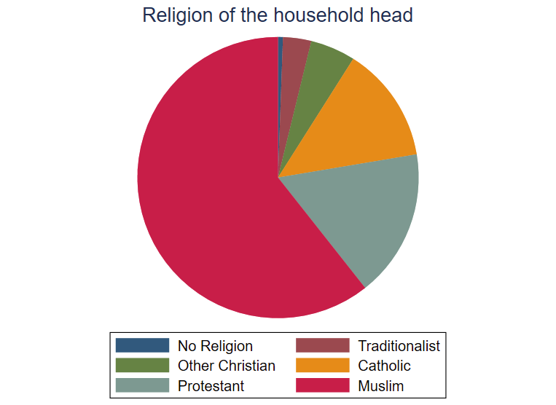
Pie chart

Slide 27
twoway graphs
Each point in the graph represents a combination of y-axis and x-axis
This is a scatter plot, but it can be any other type of graph – line, bars, area, etc.

Slide 28
Task 6: Explore relationship with Scatter Plot
Use twoway scatter to explore relationship between food and non-food consumption value
How are they related?
Use the options for the command to make the graph self-contained
Add tittles, axis-titles, etc.
Use name(graphname, replace) option to store the graph in memory

Slide 29
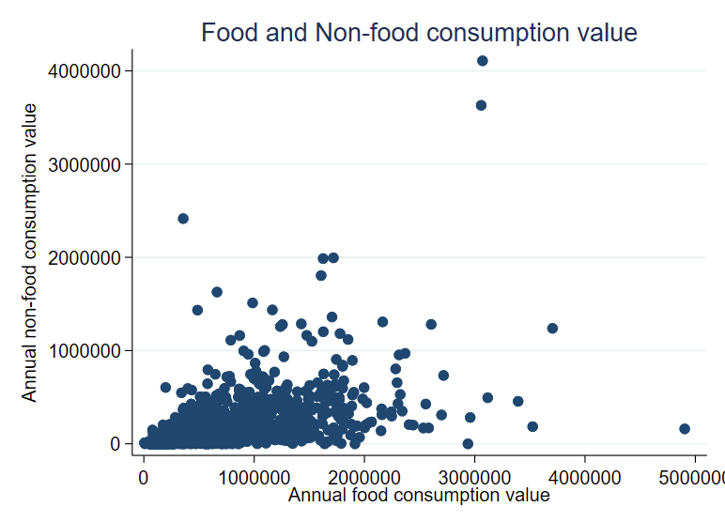
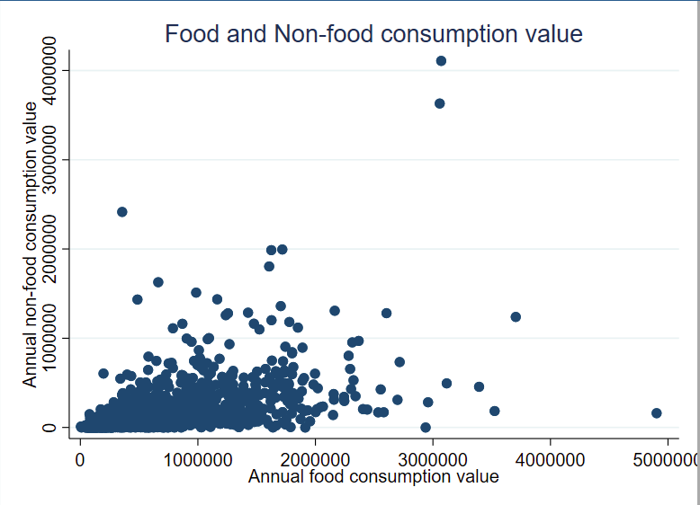
Scatter plot
With option:
ylabel(, angle(0)

Slide 30
Multiple twoway graphs in one
You can add multiple graphs in the same graphs and format the data points to differentiate
This graph has 2 types of graphs – scatter and lfit (linear prediction) for 2 different variables
twoway (type var1 var2, opts)
(type var3 var4, opts), opts

Slide 31
Task 7: Multiple twoway elements
Use gr tw to create kdensity curves of winsorized food consumption value for the three districts
gr tw (kdensity varname if catvar == “string”) ///
(kdensity varname if catvar == “string”) ///
(kdensity varname if catvar == “string”)
Add title, x-axis title, and y-axis title
title(), xtitle(), and ytitle()
Label the legend so it indicates the hub names correctly
legend(order(# “labelname” …))
Use the row()option within legend so the legend appears in one row
Use ylable(, angle(0)) option to make the labels on y-label horizontal
Change the background color to white
Use name(graphname, replace) option to store the graph in memory

Slide 32
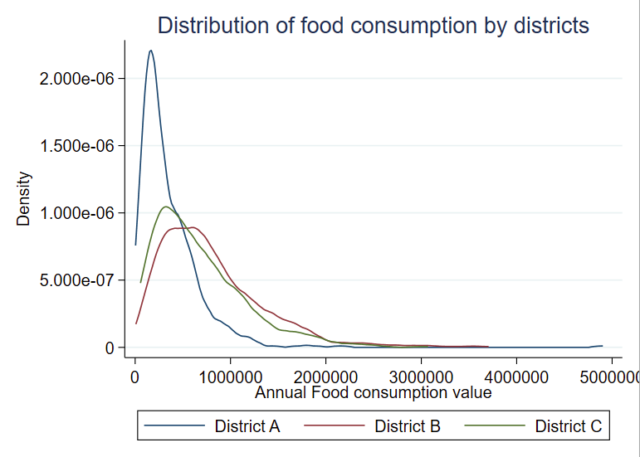
Multiple twoway graphs

Slide 33
Combining graphs
Combined graphics be used to compare and contrast data, or show incompatible view in context
Can combine oneway, twoway graphs, and custom graphs
Allows overlay of additional annotation and resizing
In Stata, command is graph combine

Slide 34
Task 8: Combine graphs
Use gr combine to combine both the graphs that were stored in memory
Use the stored names to recall the graphs
Use some of the graph options to make sure the graphs are in 1 column and have a common scale for the x-axis
Add a note to the graph that tells us the source of the data

Slide 35
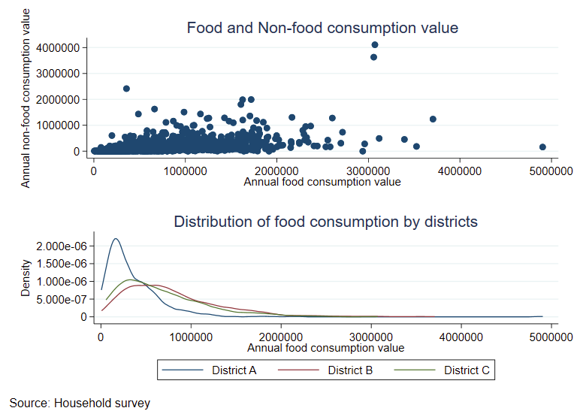
Combine graphs

Slide 36
Task 9: Export graphs
Use gr export to export the combined graph to the Output folder
gr export “filepath/graphname.png”, replace

Slide 37
Recap
We learned:
Best way to communicate results
How to show distributions and relationships in your dataset
How to make a self-contained graph
How to combine graphs
How to export graphs

Slide 38
Thank you!

Slide 39
Further Reading
https://dimewiki.worldbank.org/Stata_Coding_Practices:_Visualization
https://worldbank.github.io/Stata-IE-Visual-Library
https://dimewiki.worldbank.org/Checklist:_Reviewing_Graphs

Slide 40
Appendix

Slide 41
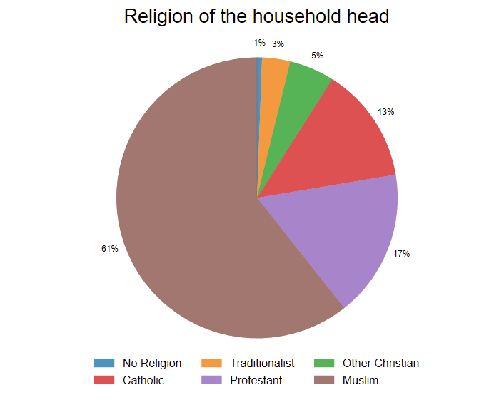
Task 10
Add labels to all the slices in the pie chart to replicate the following graph:

Slide 42
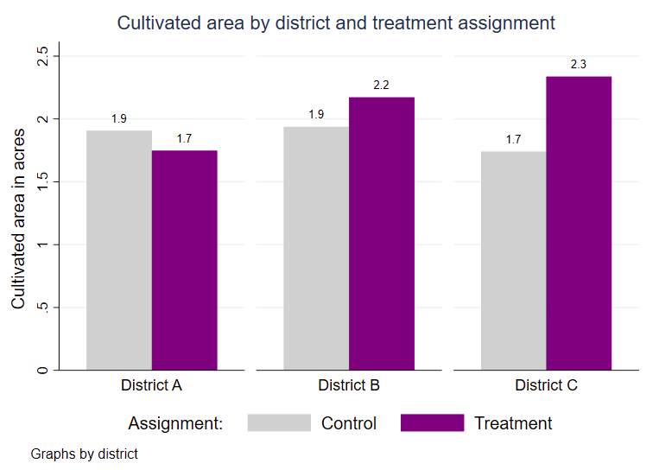
Task 11
Use gr bar with options over and by to replicate the following graph:

